Slide 1
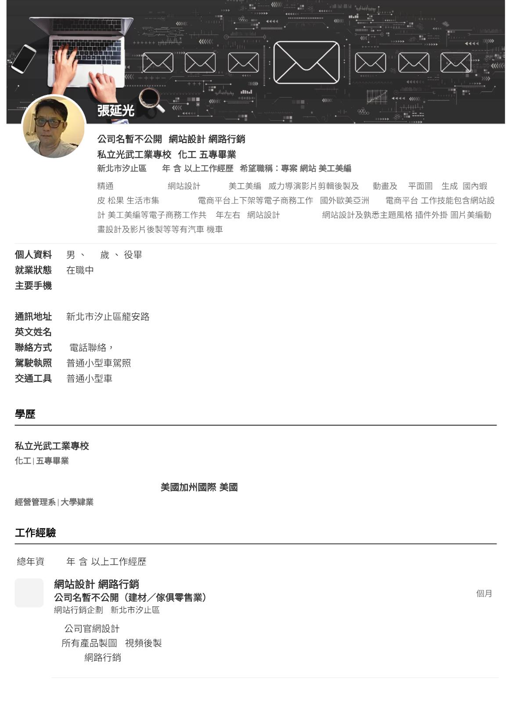
|
SEM
|
| 25
WORDPRESS
/PCHOME

(
)
|
/
/
/
/ PS/AI
10
/
✦
GIF
b2b
3D
,
ai
,
✦
:Wordpress
/
,
60
(1984/1)
0968-688-470
kyc5168@gmail.com
***
E-mail
Vincent Yen Chang
(
a.m. 9:00~ p.m. 9:00)
1979/9~1983/6
1993/9~1995/5
Caifornia International University
(
)
25 ( )

SEM
2023/8~2024/1
6
|
1.
SEO/SEM
/
2.
3.SEM

Slide 2
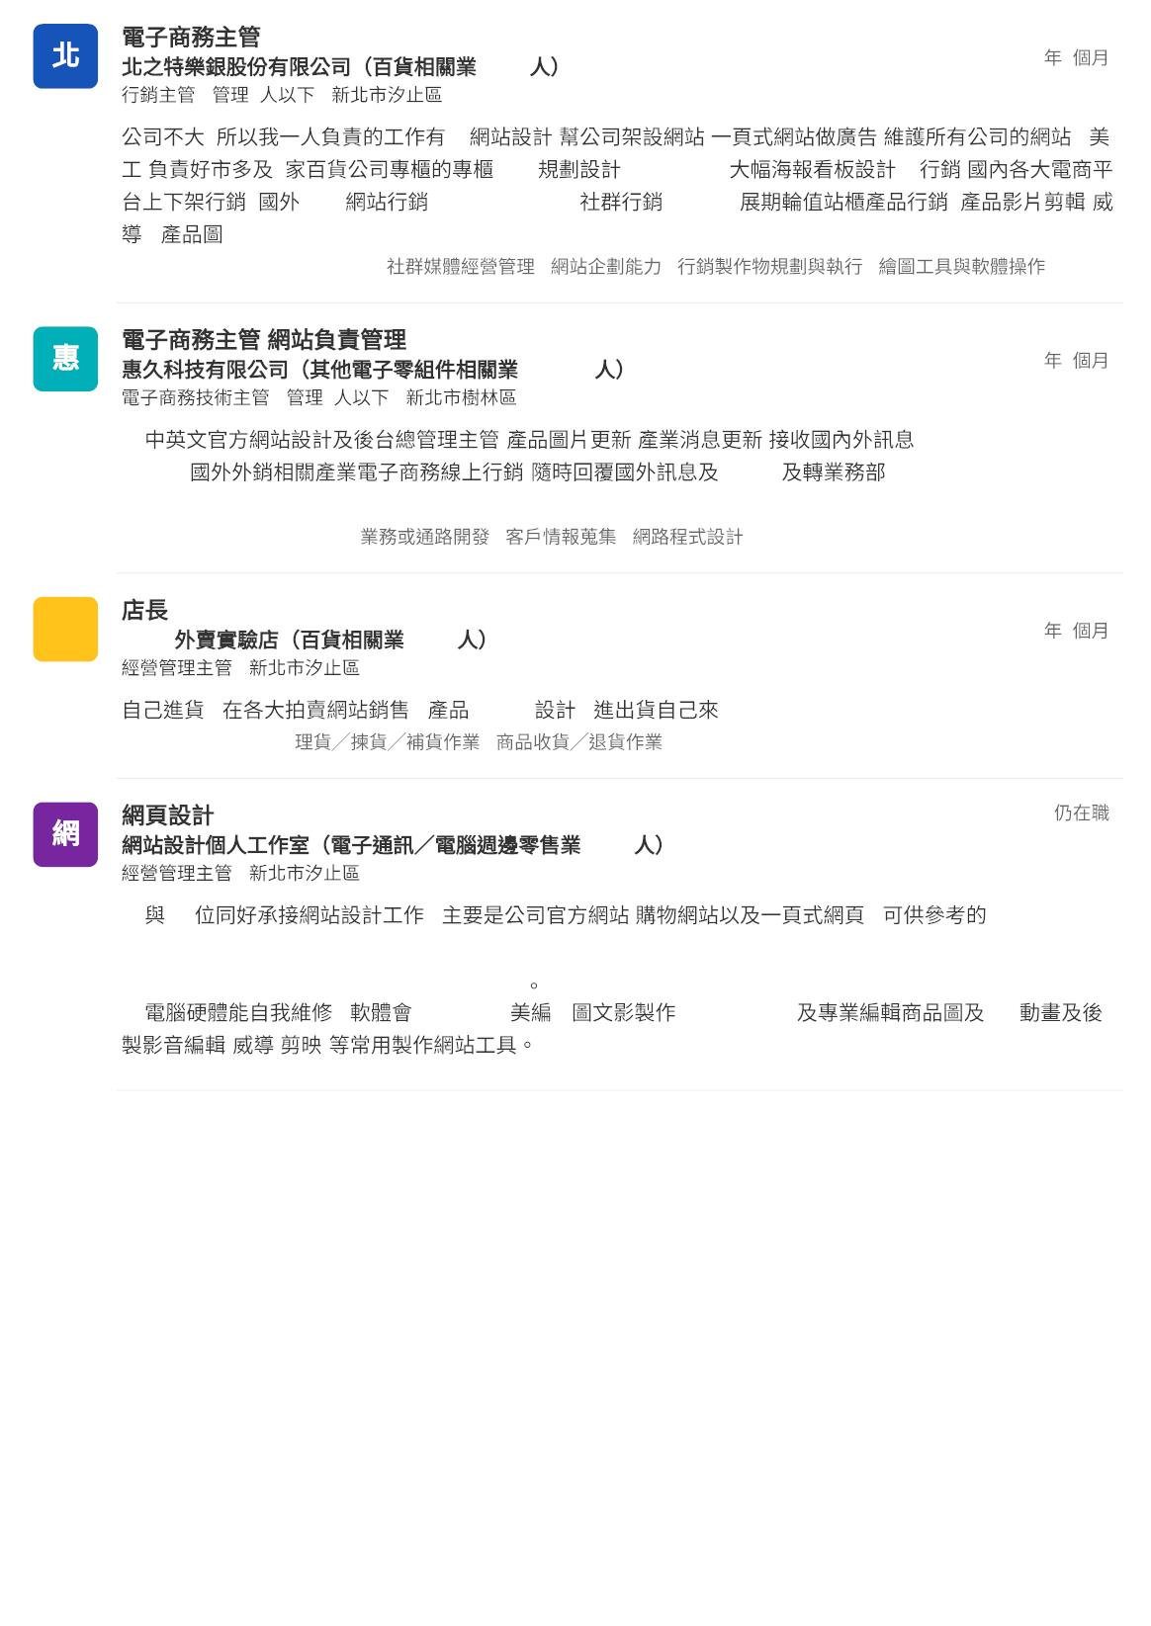
2022/6~2023/8
1~30
1
3
|
4
|
:
,
3
1.
2.3D
:
/
/EDM/POP/
/Costco
/
3.
:
2.
) /
/
B2B
/FB/LINE/IG/YT
#
/
(
GIF...
#Illustrator #Adobe Photoshop #
#
#
2018/10~2020/6
30~100
1
9
|
4
|
1.
(
/
/
)
2. B2B
(
EMAIL
)
#HTML #Adobe Photoshop #
#
#
T
2018/2~2022/5
ToGo
1~30
4
4
|
,
,
banner
#
,
#Adobe Photoshop #
1~30
2015/1~
|
1. 1.2
,
/
,
https://ambiworkstek.com/ , https://ferlo.com.tw , https://sammetal.tech , https://shengkaiprecision.com,
https://bestloving.com.tw , https://catsofa.biz
2.
(
/
)
,
photoshop
AI
/illustrator(ai)
GIF

Slide 3
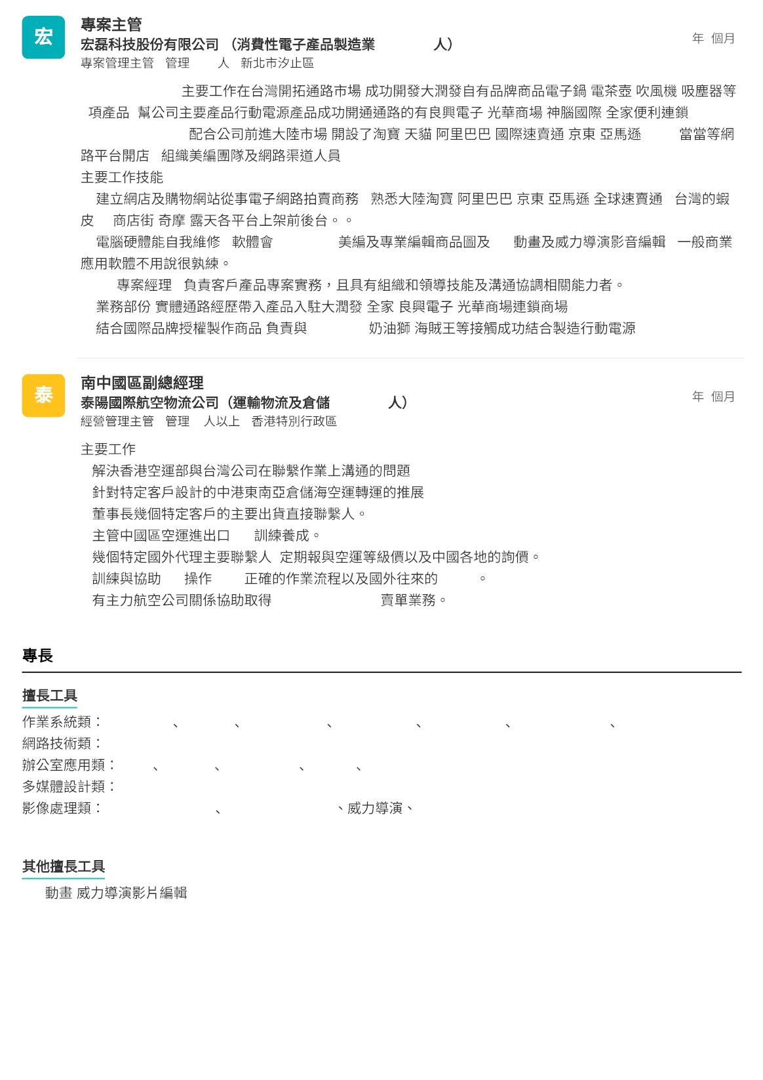
2010/9~2014/12
100~500
4
4
|
9~12
|
2010/9-2013/10
,
/
/
/
9
,
/
/
/
2013/10-2014/12
,
,
.
/
/
/
/
/
/ebay/
1.
/pc
/
/
,
/
/
/
/
/
,
2.
,
photoshop
GIF
,
3. PM
4.
:
,
/
/
5.
:
hello kitty/
/
2006/1~2009/1
100~500
3
1
|
13
|
1.
2.
3.
4.
5.
6.
7.
:
OP
,
CS
R/O
MU/CA/ZH/AK/MI
e-mail
Windows 7 Android Windows XP Windows 98 Windows 95 Windows 2003 Windows 2000
FTP
Excel Outlook PowerPoint Project Word
Painter
Adobe Photoshop Adobe Illustrator
sweethome 3D
#Android #FTP #Excel #Outlook #PowerPoint #Project #Word #Painter #Adobe Photoshop #Illustrator
GIF

Slide 4
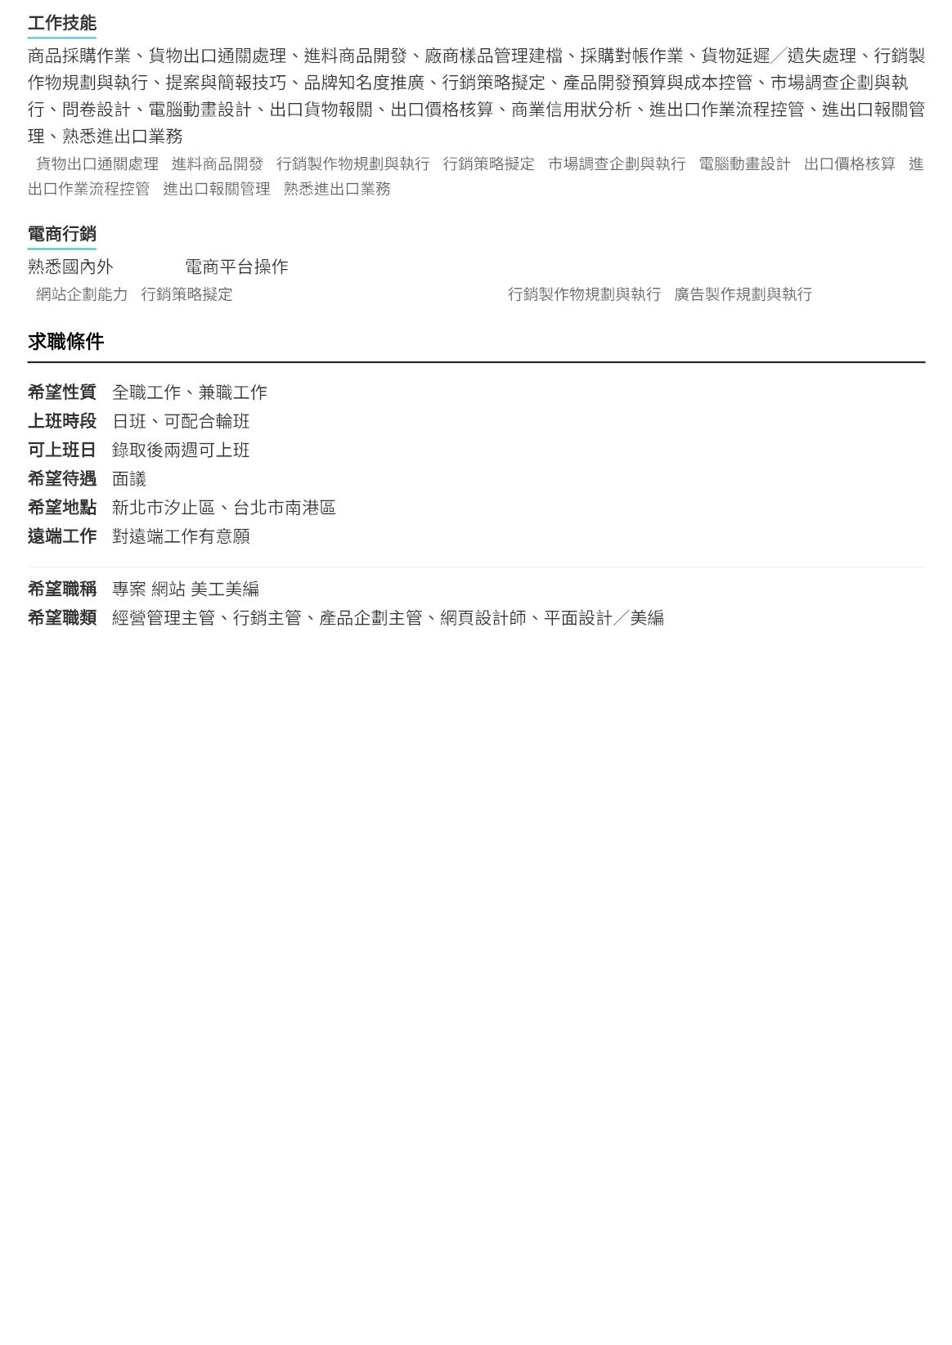
#
#
#
#
#
#
#
#
#
#
#
B2C/B2B
#
#Google Analytics #Adobe Photoshop #
#

Slide 5
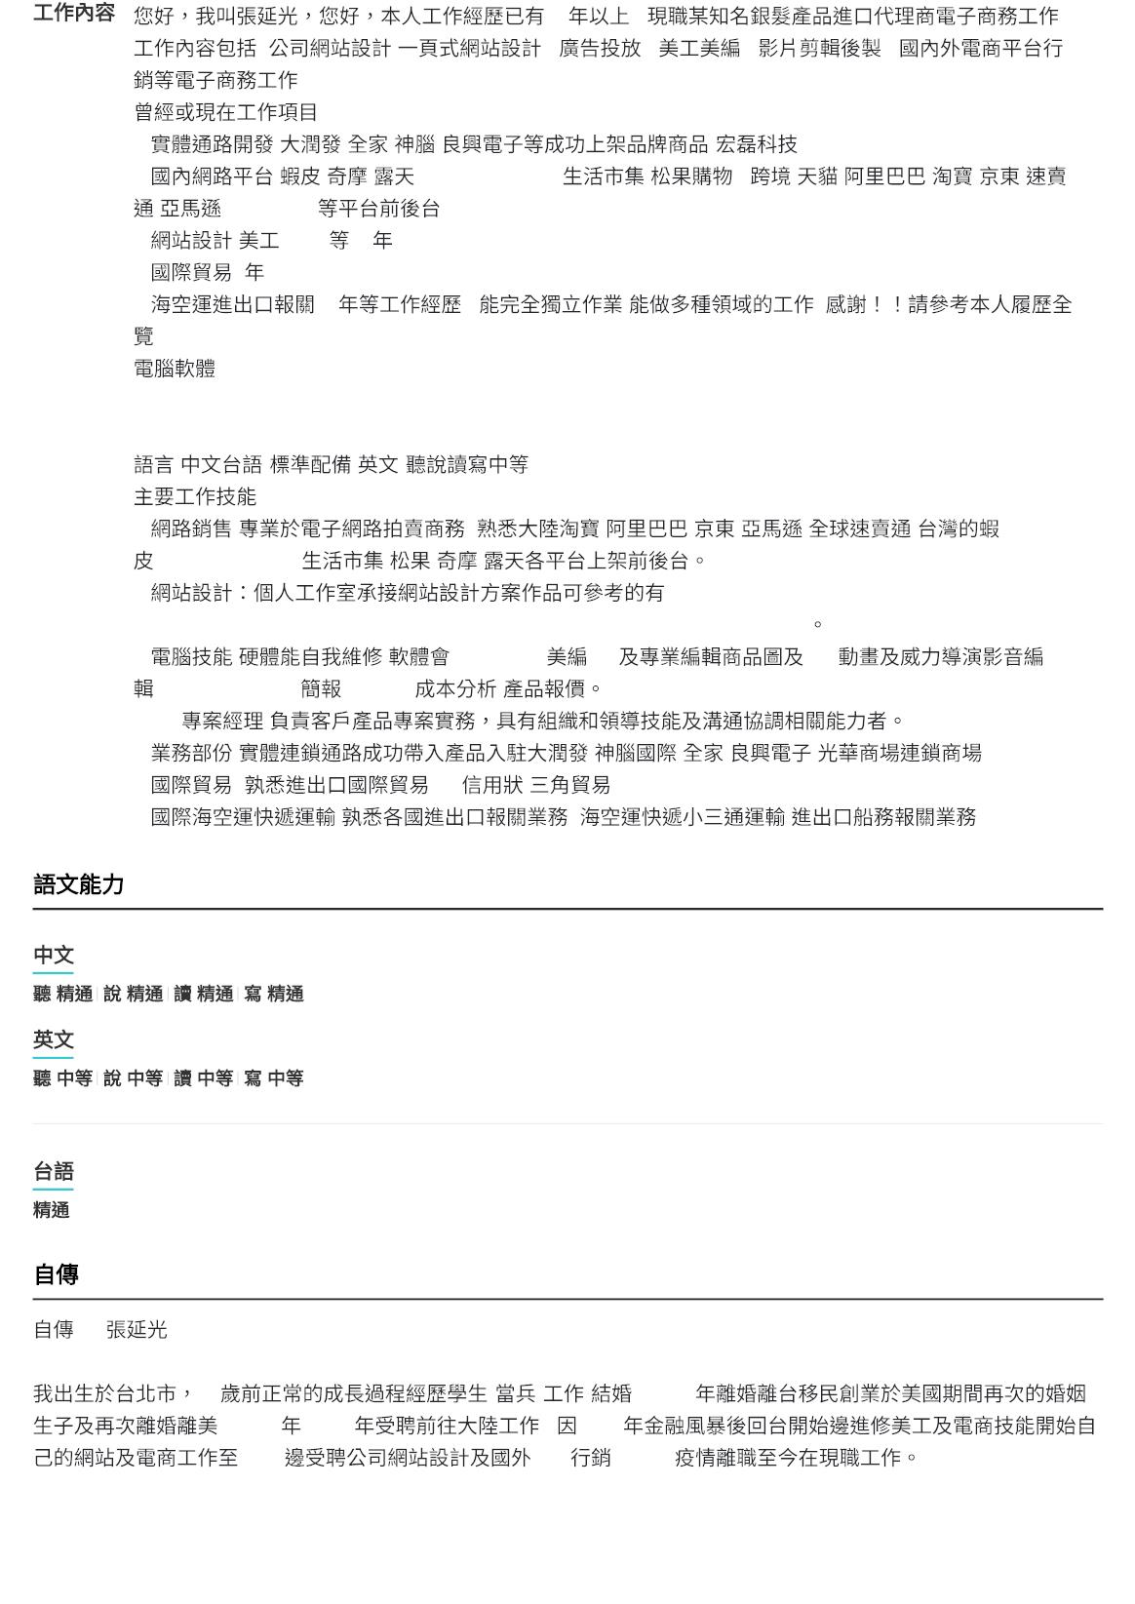
:
/
25
/
,
,
/
/
,
✦
✦
:
:
:
/
/
/
(
)
/
/
/
/pchome/momo/
/
,
:
/
/
/
/
✦
✦
✦
/eworktrad
/
/SEO 10
5
15
,
,
,
:
✦Windows/Excel/Powerpoint
✦Wordpress/Woocommerce/Photoshop/AI/Gif/
:
-
/
-
1.
2.
:
,
/
/
/
/
/pchome/momo/
/
/
/
https://ambiworkstek.com/ ,
https://ferlo.com.tw , https://sammetal.tech , https://shengkaiprecision.com
3.
:
,
photoshop
/
/AI
GIF
,POWERPOINT
,EXCEL
4.PM
5.
:
:
,
/
/
/
/
6.
/LC
/
7.
:
,
,
/
/
/
/
/
/
/
/
—
30
, 2004 -2009
2018
-
-
-
, 1995
,
2008
, 2021
B2B

Slide 6
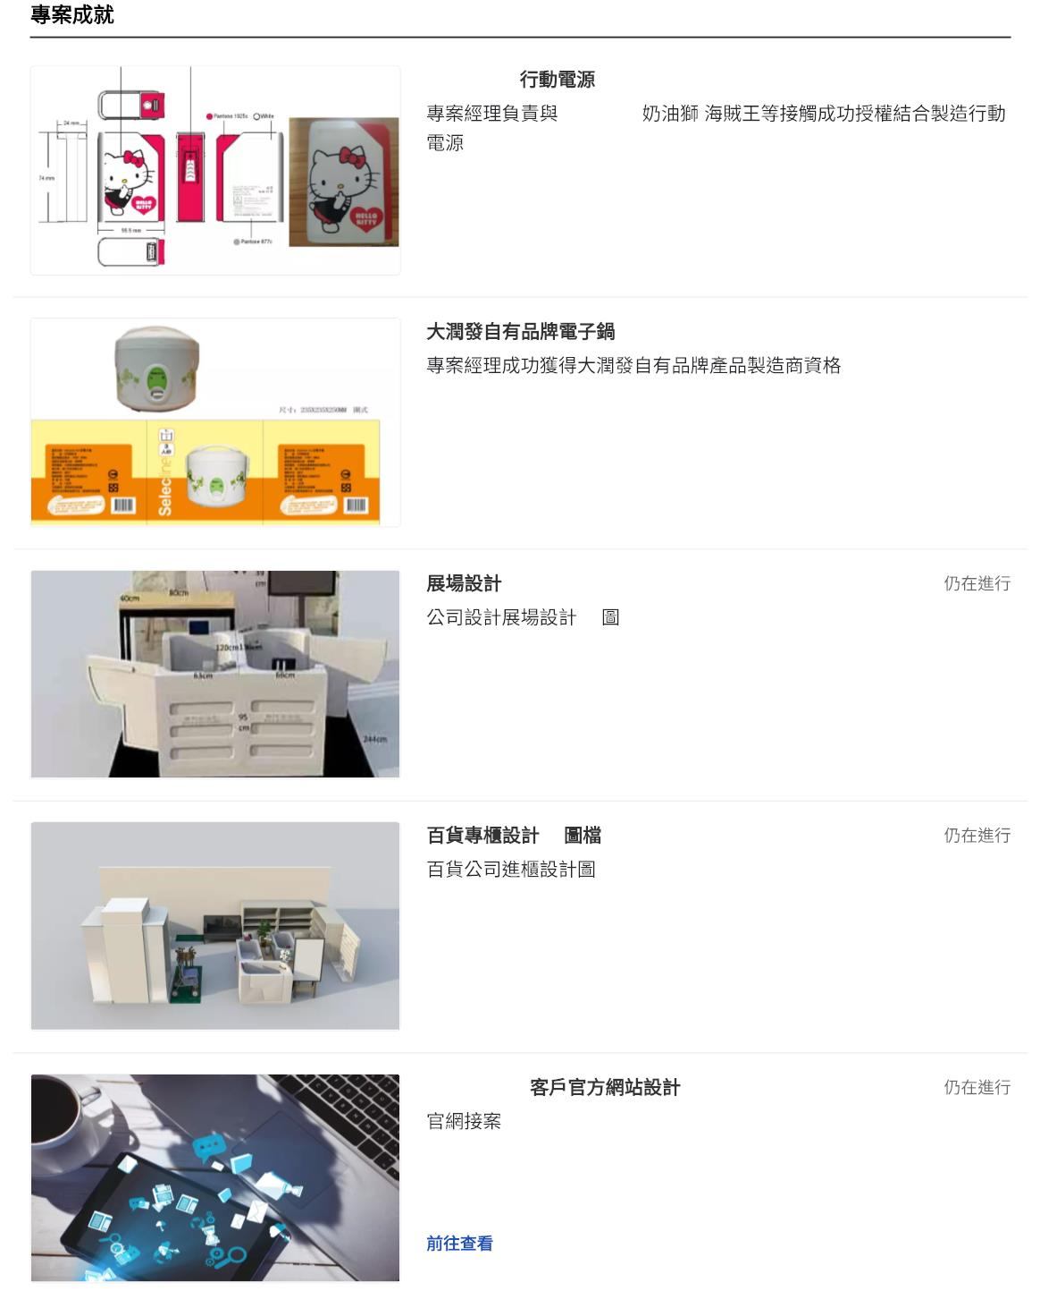
Hello Kitty
2009/1~2011/1
2008/4~2009/10
2022/6~
hello kitty/
/
3D
3D
2023/1~
Wordpress
2015/3~
1. https://ambiworkstek.com/
2. https://shengkaiprecision.com/
3. https://ferlo.com.tw


